Slide 1
CECS 450 Project 2
Presented by : Ian Schenck, Martin Mao, Adheep Shetty, Anirudhha Shinde, Suraj Nair

Slide 2
Visualization Goals
Our visualization goal is to answer a variety of user questions. Our visualization allows the user to analyze the relationship between information processing measures and effectiveness & efficiency measures, and how these relationships differ between user groups.
User groups in question: graph - normal, graph - expert, tree - normal, and tree - expert.
Questions :
1)Did one user group struggle more with information search/processing activities compared to the other user group
2)Did one user group have to search/process many more visual objects of interest in order to complete the given tasks compared to the other user group, etc.?

Slide 3
Measures of Effectiveness & Efficiency
Efficiency is indirectly measured by the time the participant spent on the visualization task
Effectiveness is measured through a success score that takes into account identification success and creation success.

Slide 4


Measures of Information Processing
Average Fixation Duration - longer average fixation duration indicates the user is spending more time processing information.
Search-to-Process ratio - larger ratio indicates the participant spends more time searching for information than processing it.

Slide 5
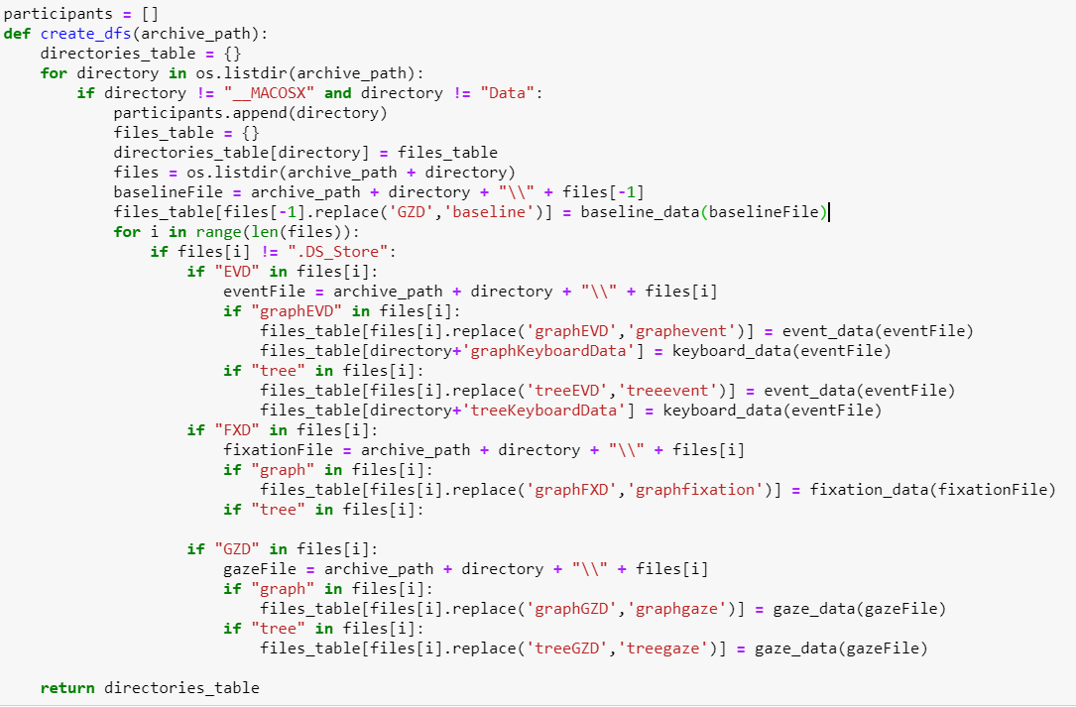
Data Preprocessing
1.Added event data, fixation data & gaze data in directories_table dictionary.
2.While importing fixation data, only considered X & Y values that are greater than 0 and less than 1600 & 1200 respectively.
3.To access any of the dataframe from the directories table, you just need to have participant id and the filename that you are trying to access.

Slide 6
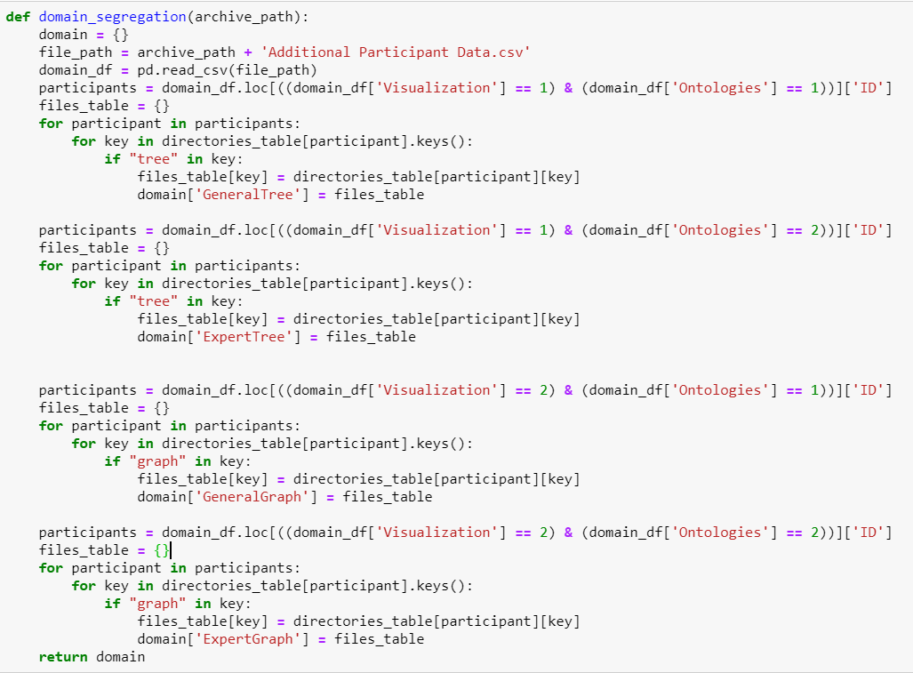
Domain Segregation
1) The code segregated the participant data as per their ontology and visualization technique.
2)
 | Ontology | Visualization
GeneralTree | 1 | 1
GeneralGraph | 1 | 2
ExpertTree | 2 | 1
ExpertGraph | 2 | 2

Slide 7
Visualization: Parallel Coordinates
We can color code the different coordinates to show the relationship between different coordinates within the data, how one parameter will affect others.
We are able to drag the parameter we trying to comparing into different position to better compare
We have the scatter plot to visualize the relationship for information processing measures and effectiveness & efficiency measures.

Slide 8
Contribution
Ian Schenck: Data Processing and Visualization using parallel coordinates
Martin Mao: Visualization using parallel coordinates and scatter plot
Adheep Shetty : Data Preprocessing of different domains and integrated values to the overall visualization.
Anirudha Shinde : Created HeatMap for the fixation Suraj Nair : Analyzed data to use for the visualization and created scanpath for the event data.

